Slide 1
Elementary Graph Algorithms
Md Amjad Hossain

Slide 2
Introduction
Graphs are abstract data types that are applicable to numerous problems
Can capture entities, relationships between them, the degree of the relationship, etc.
This lesson covers basics in graph theory, including representation, and algorithms for basic graph-theoretic problems

Slide 3
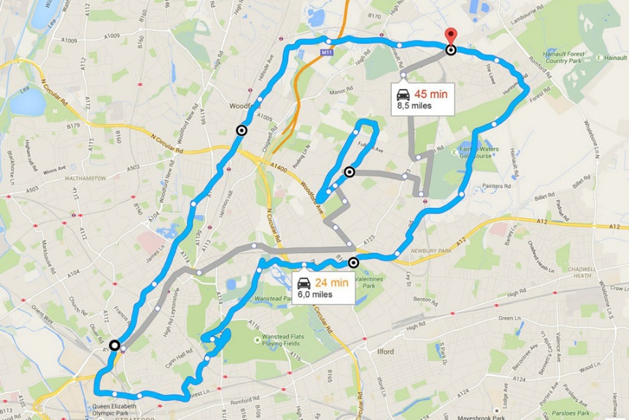
Graph Application(s)
Google maps uses graphs for building transportation systems,
Nodes- road intersections
Edges – confections between intersections
Algorithm: find shortest path between two cities
Ann Arbor
50
Detroit
40
60
120
Cleveland
130
Pittsburgh
260
Toledo
320
Chicago
148
155
150
Fort Wayne
180
Philadelphia
180
120
180
Indianapolis
Columbus

Slide 4

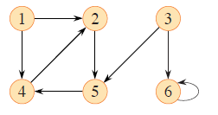




Introduction
G=(V, E)
V = vertex set
E = edge set
Graph representation
Adjacency list
Adjacency matrix
Graph search
Breadth-first search (BFS)
Depth-first search (DFS)
Topological sort
Strongly connected components
Undirected Graph
Directed Graph
12
0
-6
7
3
4
Weighted Graph

Slide 5
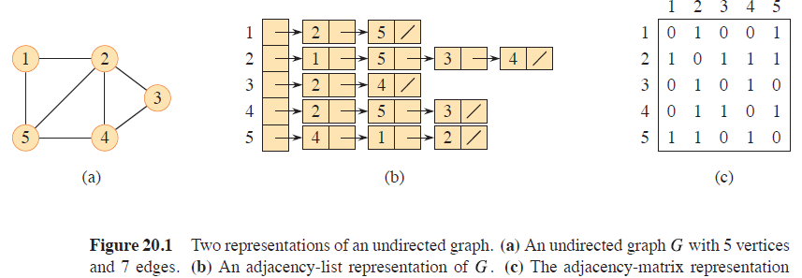
Representation For A Undirected Graph
2 entries per edge
Adjacency List:
For each vertex v ∈ V , store a list of vertices adjacent to v
For weighted graphs, add information to each node
Adjacency Matrix:
Use an n × n matrix M , where M (i, j) = 1 if (i, j) is an edge, 0 otherwise
If G weighted, store weights in the matrix, using ∞ for non-edges

Slide 6
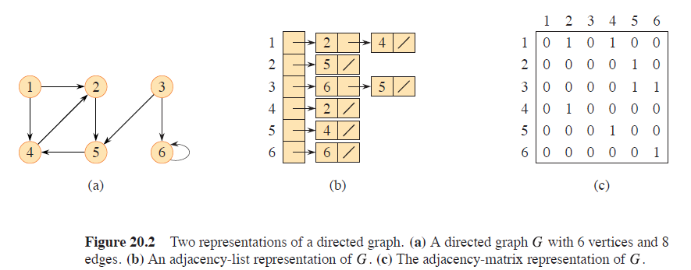
Representation For A Directed Graph
1 entry per edge
Adjacency List:
For each vertex v ∈ V , store a list of vertices adjacent to v
For weighted graphs, add information to each node
Adjacency Matrix:
Use an n × n matrix M , where M (i, j) = 1 if (i, j) is an edge, 0 otherwise
If G weighted, store weights in the matrix, using ∞ for non-edges

Slide 7
Representation of Graphs
Adjacency list: Θ(V+E)
Preferred for sparse graph
|E| << |V|²
Adj[u] contains all the vertices v such that there is an edge (u, v) ∈E
Weighted graph: w(u, v) is stored with vertex v in Adj[u]
No quick way to determine if a given edge is present in the graph
Adjacency matrix: Θ(V²)
Preferred for dense graph
Symmetry for undirected graph
Weighted graph: store w(u, v) in the (u, v) entry
Easy to determine if a given edge is present in the graph

Slide 8
Graph Traversals Algorithms
Breadth-First Search (BFS)
Depth-First Search (DFS)

Slide 9
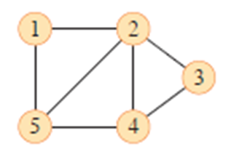
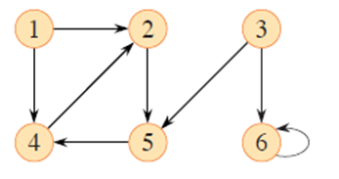
Breadth-First Search (BFS)
Graph search: given a source vertex s, explores the edges of G to discover every vertex that is reachable from s
Compute the distance (smallest number of edges) from s to each reachable vertex.
Produce a breadth-first tree with root s that contains all reachable vertices.
Compute the shortest path from s to each reachable vertex
BFS discovers all vertices at distance k from s before discovering any vertices at distance k+1

Slide 10
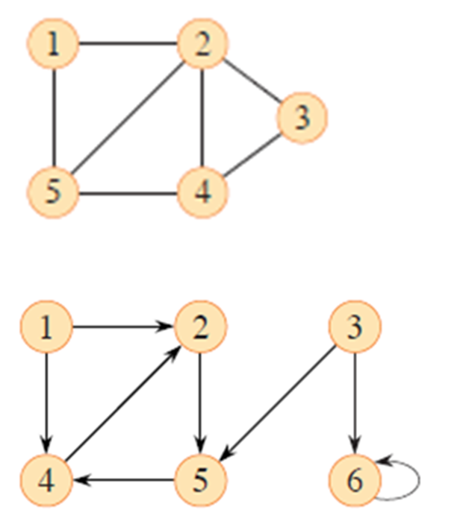
Data Structures for BFS
Adjacency list
color[u] for each vertex
WHITE if u has not been discovered
BLACK if u and all its adjacent vertices have been discovered
GRAY if u has been discovered, but has some adjacent white vertices
Frontier between discovered and undiscovered vertices
d[u] for the distance from s to u
π[u] for predecessor of u
FIFO queue Q to manage the set of gray vertices
Q stores all the gray vertices

Slide 11
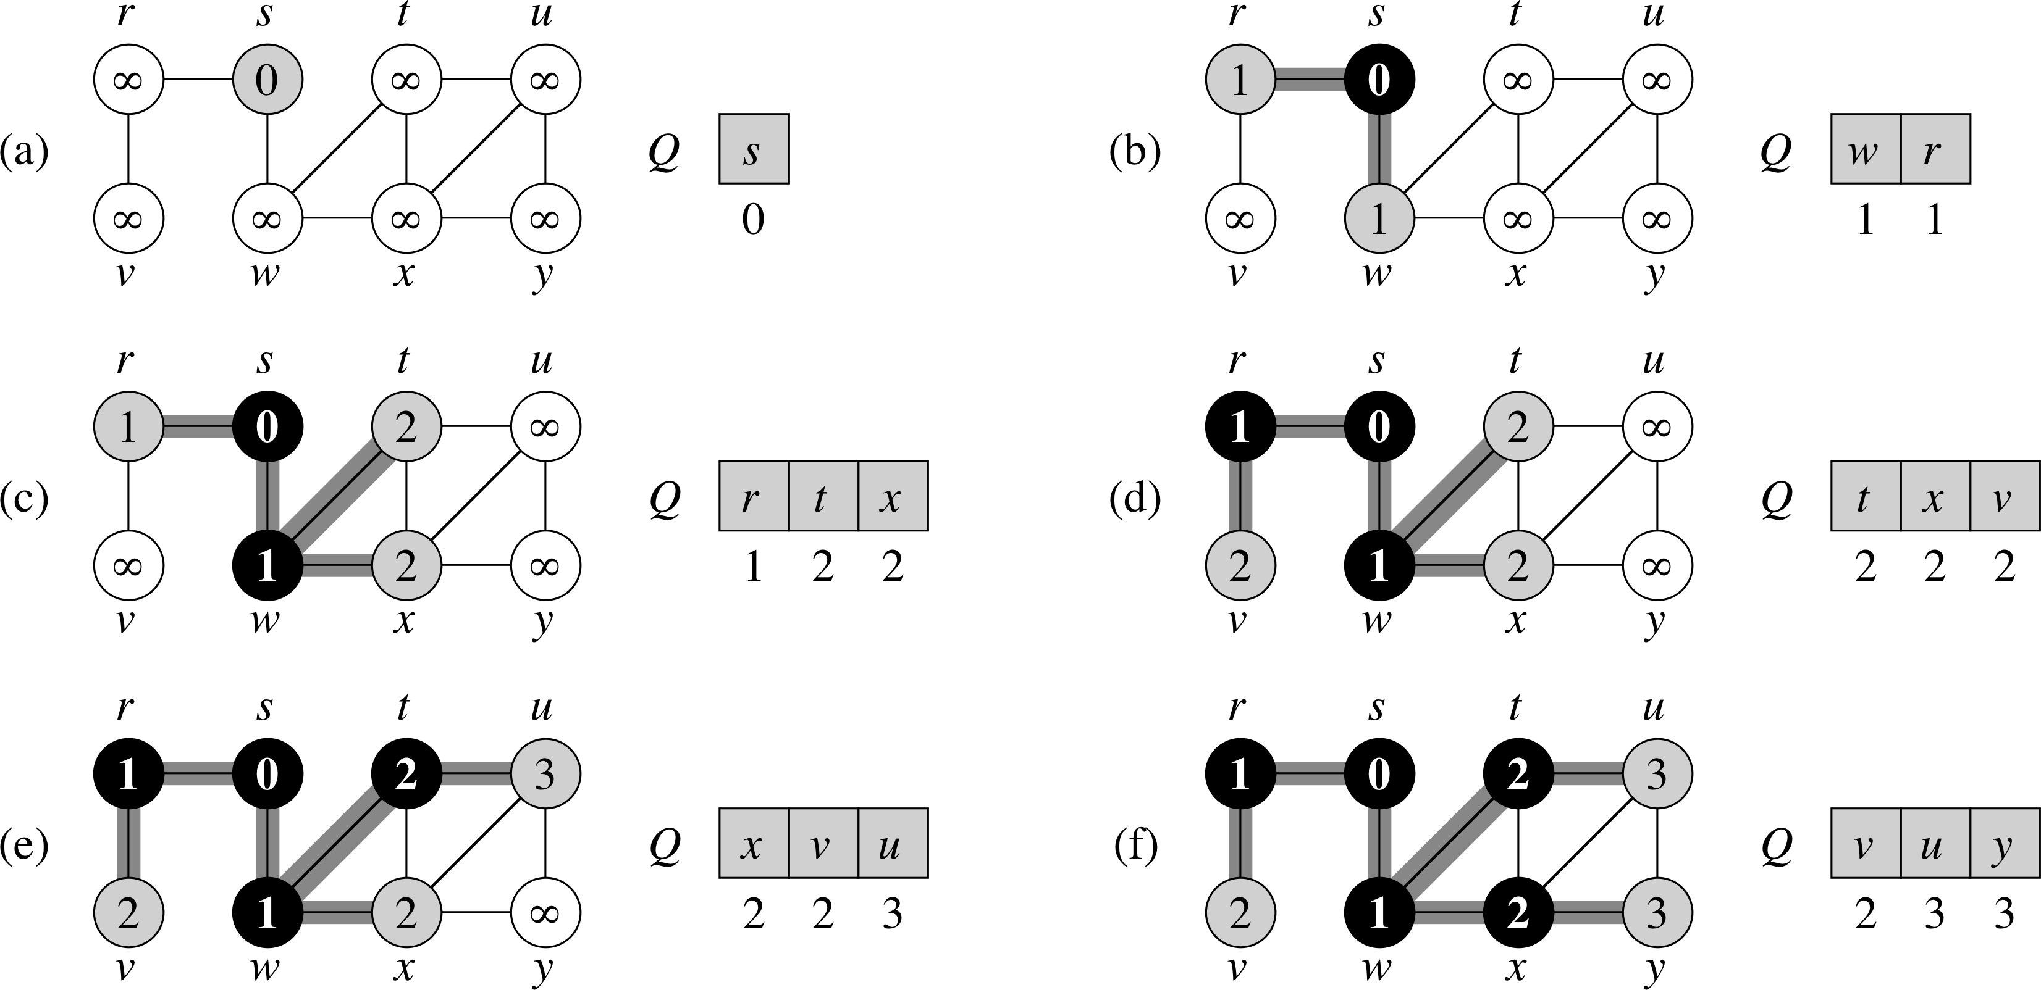
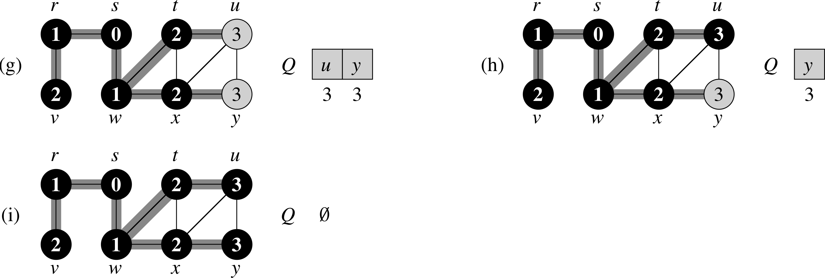
BFS Example ( G, s are given)

Slide 12
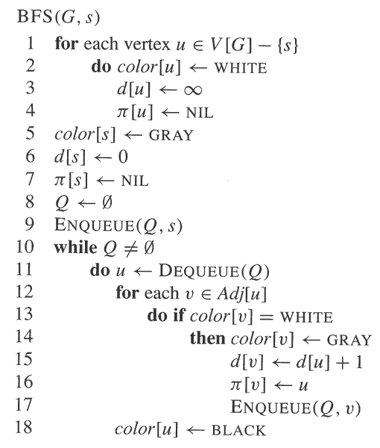
Initialization
Set up s and initialize Q
Explore all the vertices adjacent to
u and update d, π and Q

Slide 13
Analysis of BFS
O(V+E)
Each vertex is en-queued (O(1)) at most once ➔ O(V)
Each adjacency list is scanned at most once ➔ O(E)
Print out the vertices on a shortest path from s to v
After the end of the algorithm, d[v] = shortest distance from s to v
⇒ Solves unweighted shortest paths
Can print the path from s to v by recursively following π[v], π[π[v]], etc.
If d[v] == ∞, then v not reachable from s
⇒ Solves reachability

Slide 14
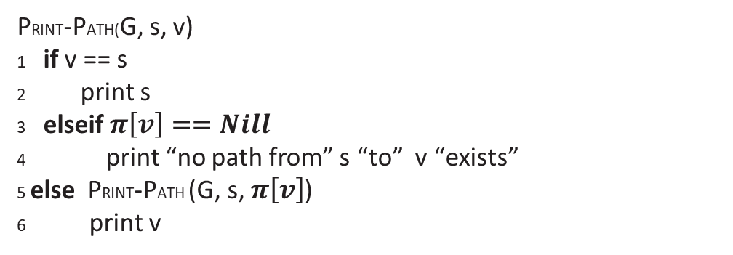
PRINT-PATH Illustration
PRINT-PATH(G, s, v)
1 if v == s
2 print s
3 elseif $π\left[v\right]==Nill$
4 print “no path from” s “to” v “exists”
5 else PRINT-PATH (G, s, $π\left[v\right]$)
6 print v
PRINT-PATH(G, s, y)
PRINT-PATH(G, s, x) y
PRINT-PATH(G, s, w) x y
PRINT-PATH(G, s, s) w x y
s w x y
Use the parent list and follow the path backward in the BFS tree

Slide 15
Depth-First Search (DFS)
DFS: search deeper in the graph whenever possible
Edges are explored out of the most recently discovered vertex v that still has unexplored edges leaving it
When all of v’s edges have been explored (finished), the search backtracks to explore edges leaving the vertex from which v was discovered
This process continues until we have discovered all the vertices that are reachable from the original source vertex
If any undiscovered vertices remain, then one of them is selected as a new source and the search is repeated from that source
The entire process is repeated until all vertices are discovered
DFS will create a forest of DFS-trees

Slide 16
Data Structure for DFS
Adjacency list
color[u] for each vertex
WHITE if u has not been discovered
GRAY if u is discovered but not finished
BLACK if u is finished
Timestamps: 1 ≤ d[u] < f[u] ≤ 2|V|
d[u] records when u is first discovered (and grayed)
f[u] records when the search finishes examining u’s adjacency list (and blacken u)
π[u] for predecessor of u

Slide 17
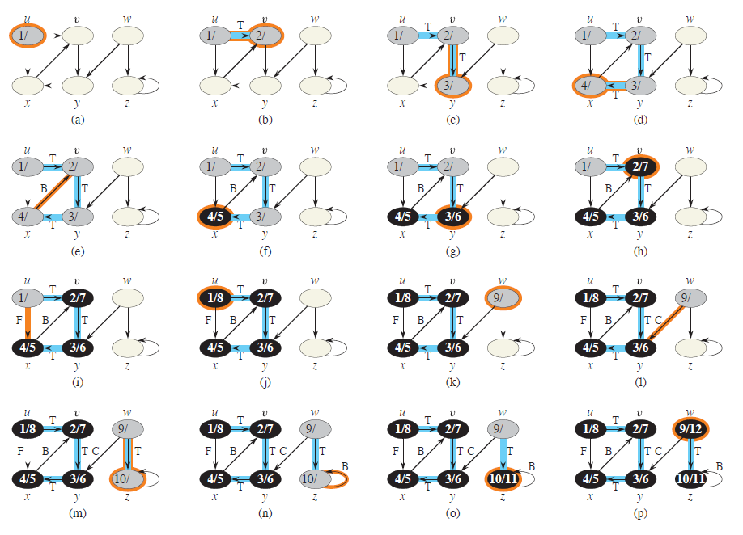
DFS Example

Slide 18
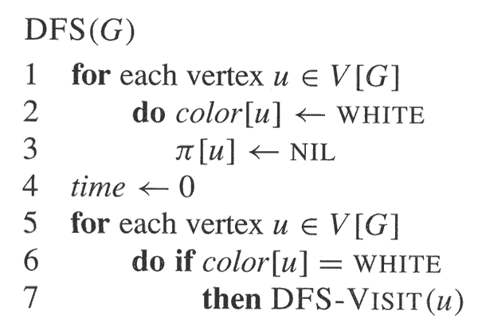
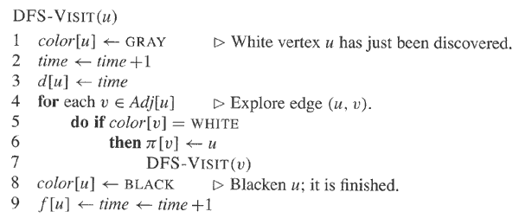

Slide 19
Properties of DFS
Time complexity: Θ(V+E)
Loops on lines 1-3 and 5-7 of DFS: Θ(V)
DFS-VISIT
Called exactly once for each vertex
Loops on lines 4-7 for a vertex v: |Adj[v]|
Total time =
DFS results in a forest of trees
Discovery and finishing times have parenthesis structure
Theorem 20.7

Slide 20
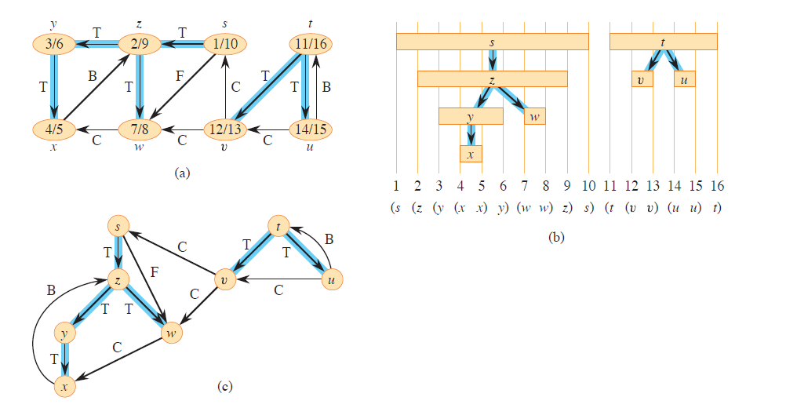
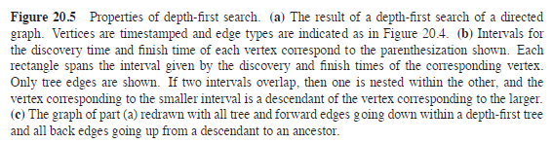
DFS Example

Slide 21
Classification of Edges
Tree edges are edges in the DFS forest. Edge (u, v) is a tree edge if it was first discovered by exploring edge (u, v).
v is WHITE
Back edges are those edges (u, v) connecting a vertex u to an ancestor v in a DFS tree. Self-loops, which may occur in directed graphs, are considered to be back edges.
v is GRAY
Forward edges are those non-tree edges (u, v) containing a vertex u to a descendant v in a DFS tree
v is BLACK and d[u] < d[v]
Cross edges are all other edges. They can go between vertices in the same tree, as long as one vertex is not an ancestor of the other, or they can go between vertices in different DFS trees.
v is BLACK and d[u] > d[v]
In a depth-first search of an undirected graph G, every edge of G is either a tree edge or a back edge. (Theorem 22.10)

Slide 22
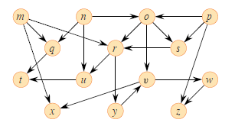
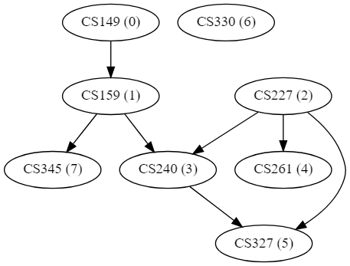
Topological Sort
A topological sort of a directed acyclic graph (DAG) is a linear order of all its vertices such that if G contains an edge (u, v), then u appears before v in the ordering.
If the graph is not acyclic, then no linear ordering is possible.
A topological sort can be viewed as an ordering of its vertices along a horizontal line so that all directed edges go from left to right
DAG are used in many applications to indicate precedence among events.
a directed acyclic graph (DAG)
Course prerequisite graph-(DAG)

Slide 23
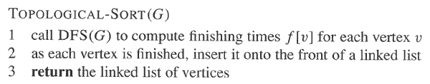
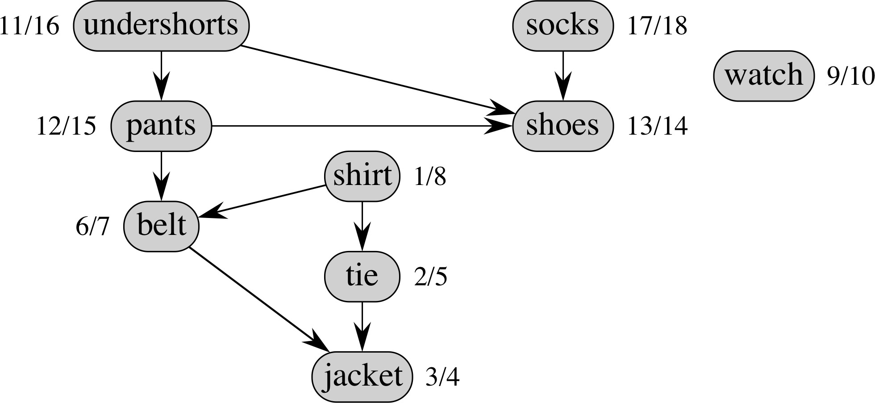
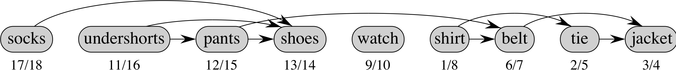
Example of Topological Sorting
Topological Sorted list
DAG

Slide 24
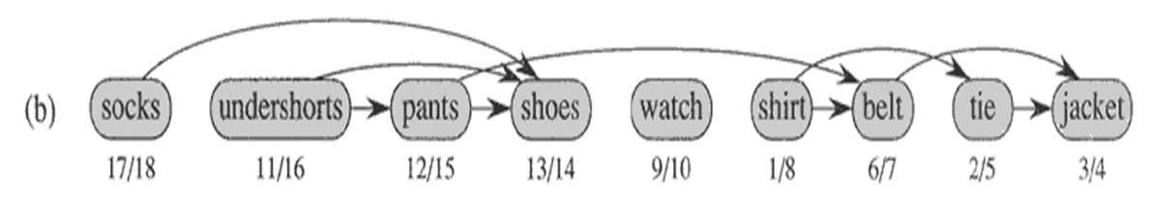
Topological Sort Algorithms
Θ(V+E)
Thus, topological sort is a descending sort of vertices based on DFS finishing times
Why does it work?
When a node is finished, it has no unexplored outgoing edges; i.e. all its descendant nodes are already finished and inserted at later spot in final sort

Slide 25
An alternative algorithm: Topological sort
topoSort1( Graph g, List topoOrderList ){
for each vertex v that has no successor
topoOrderList.push_front( v )
delete v and its edges from g
}

Slide 26
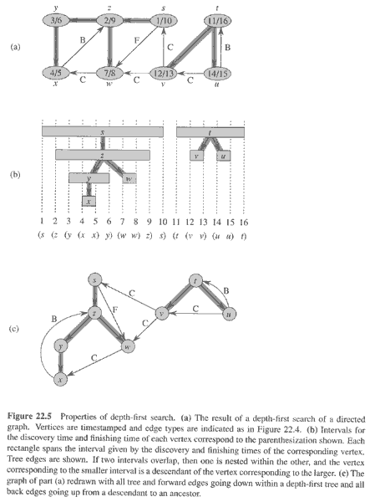
Lemma 20.11
DAG is acyclic if and only if DFS of G yields no back edges
➔Suppose that there is a back edge (u, v). Then vertex v is an ancestor of vertex u in the depth-first forest. There is thus a path from v to u in G, and the back edge (u, v) completes a cycle
⬅Suppose that G contains a cycle c. We show that a DFS of G yields a back edge. Let v be the first vertex to be discovered in c, and let (u, v) be the preceding edge in c. At time d[v], the vertices of c form a path of white vertices from v to u. By the white-path theorem (Theorem 20.9), vertex u becomes a descendant of v in the depth-first forest. Therefore, (u, v) is a back edge.

Slide 27
Theorem 20.12
TOPOLOGICAL-SORT(G) produces a topological sort of a directed acyclic graph G.
Suppose that DFS is run on a given DAG G to determine finishing times for its vertices. It suffices to show that for any pair of distinct vertices u, v, if there is an edge in G from u to v, then f[v] < f[u].
The linear ordering is corresponding to finishing time ordering
Consider any edge (u, v) explored by DFS(G). When this edge is explored, v cannot be gray (otherwise, (u, v) will be a back edge). Therefore v must be either white or black
If v is white, v becomes a descendant of u, f[v] < [u] (ex. pants & shoes)
If v is black, it has already been finished, so that f[v] has already been set ➔ f[v] < f[u] (ex. belt & jacket)

Slide 28
Chapter Exercise
http://csc.columbusstate.edu/carroll/6109/graphs/graphsExercises.html
Important terms : http://csc.columbusstate.edu/carroll/6109/graphs/graphsTerminology.html

